Slide 1

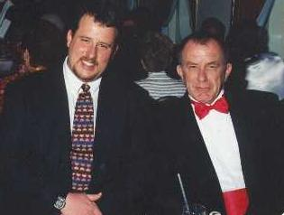
Exposure CS 2021
for CS1
Chapter 7 Section 1-5 Slides
Keyboard Input and
1-Way Selection Control Structures
PowerPoint Presentation
created by:
Mr. John L. M. Schram
and Mr. Leon Schram
Authors of Exposure
Computer Science

Slide 2
Section 7.1
Keyboard
Input

Slide 3
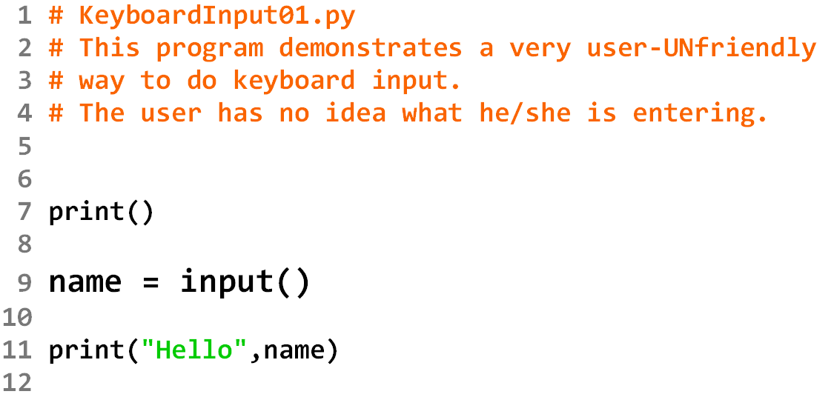
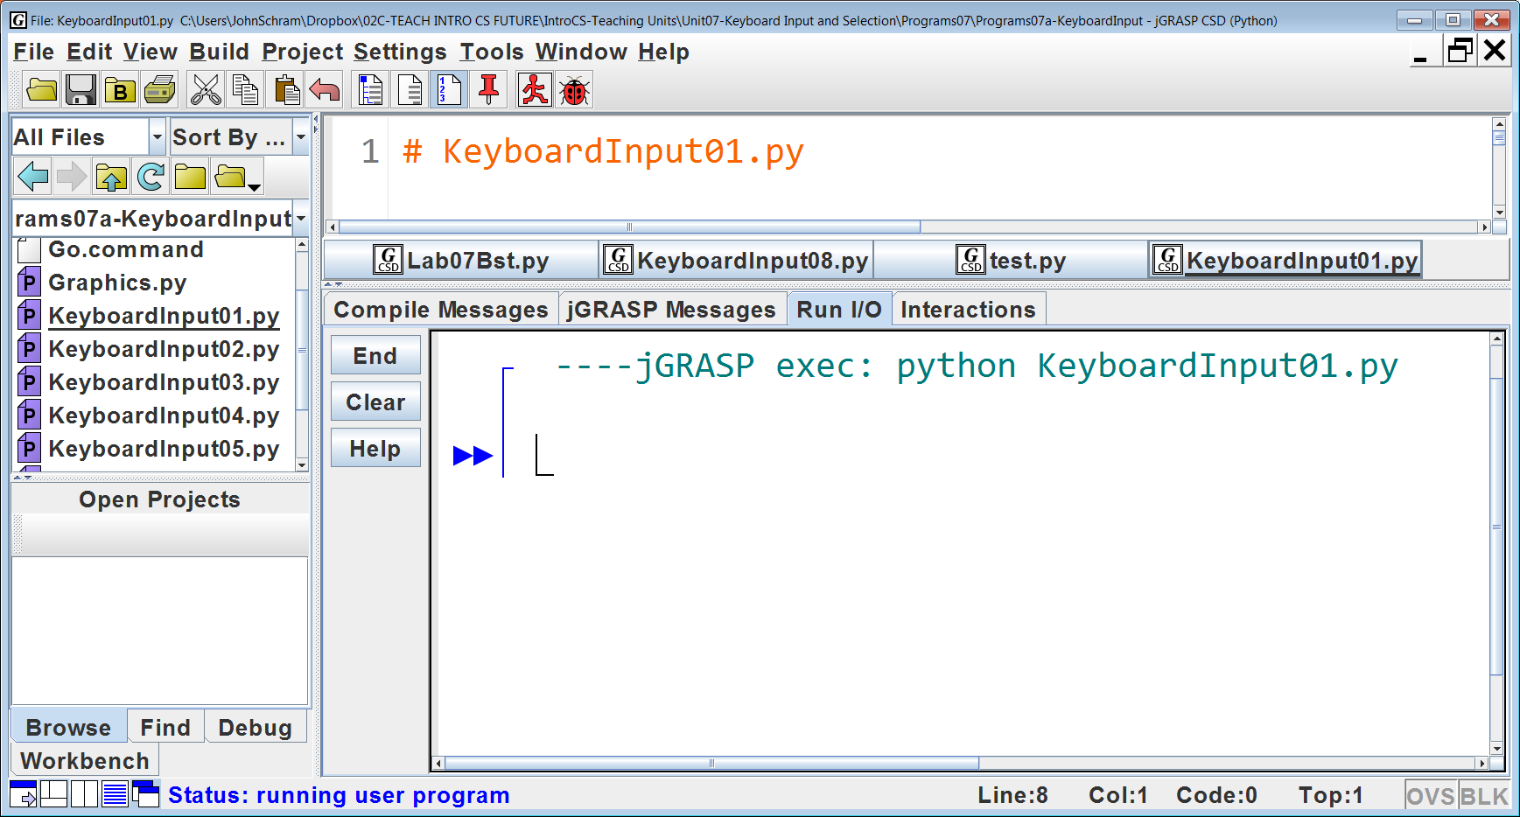
Initial Output: All we see is a blinking cursor.

Slide 4
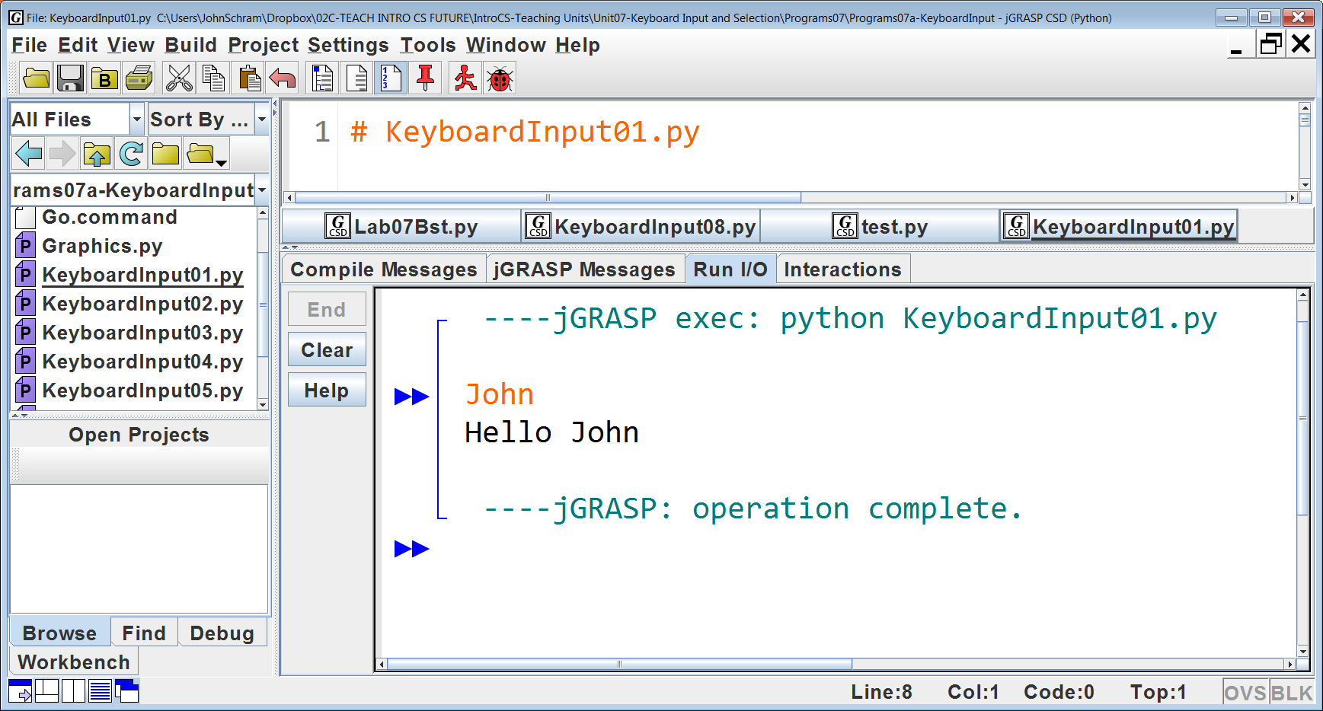
If the user has knowledge of the inner workings of the program (something that cannot be assumed) he/she will enter his/her name and then the program execution can continue.
To prove that the name was entered, it is displayed in the form of a greeting.

Slide 5
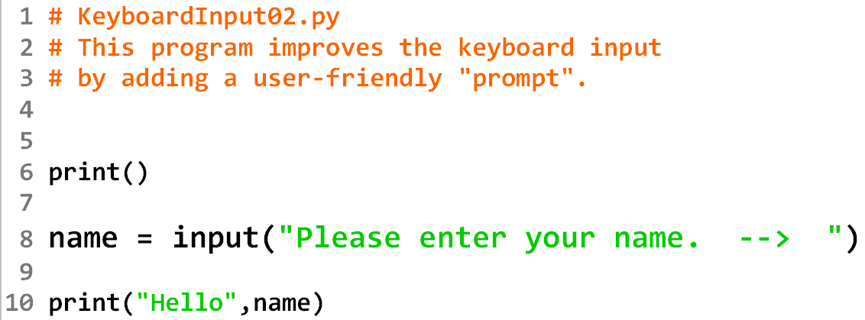
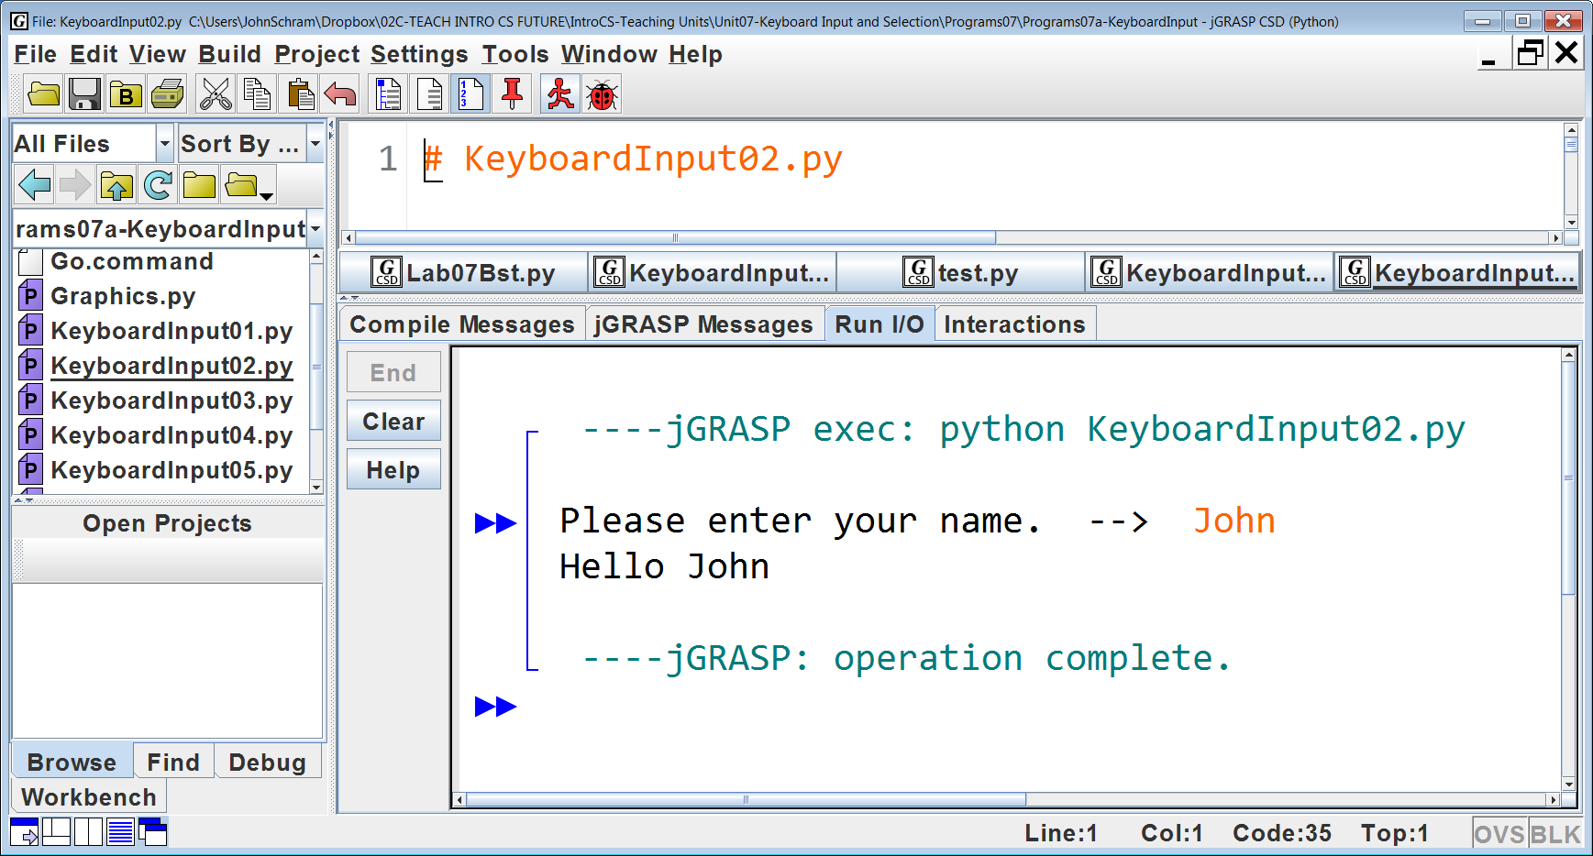
When you first run the program, all you see is the prompt.

Slide 6
Then you type your name.

Slide 7
When you press <enter> you see the rest of the program output.

Slide 8

Enter a different name – get a different output.

Slide 9
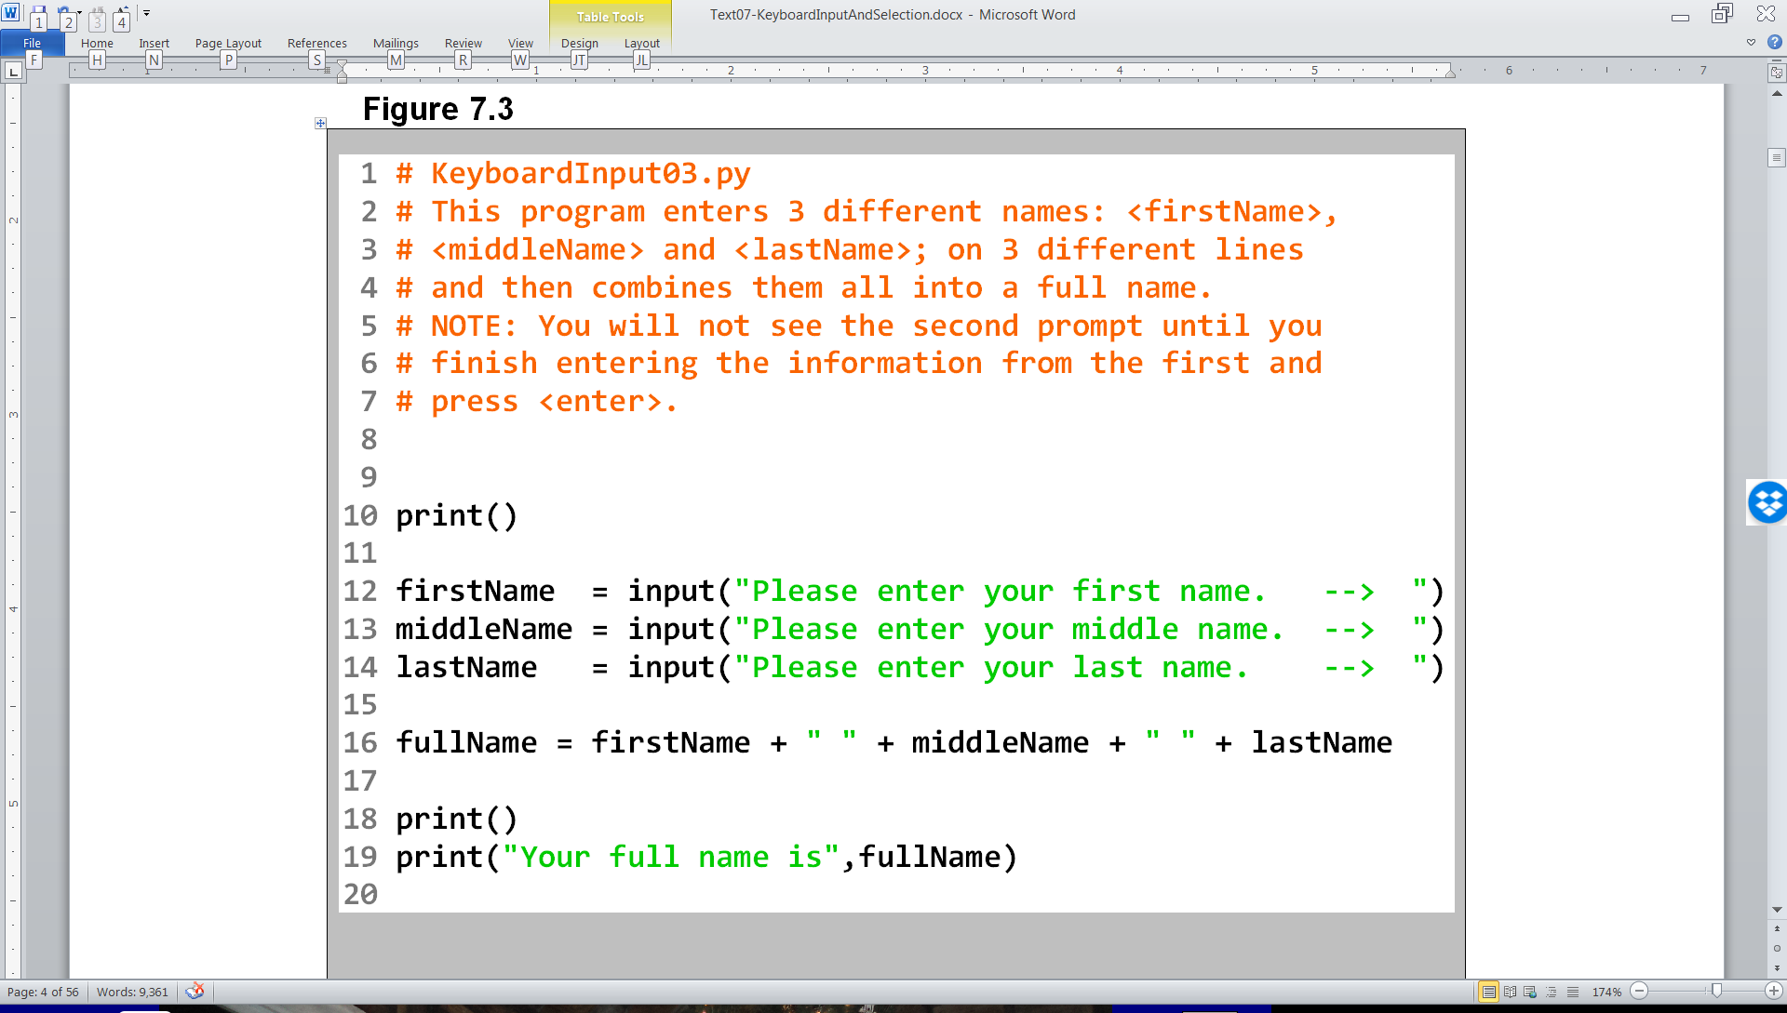

Slide 10
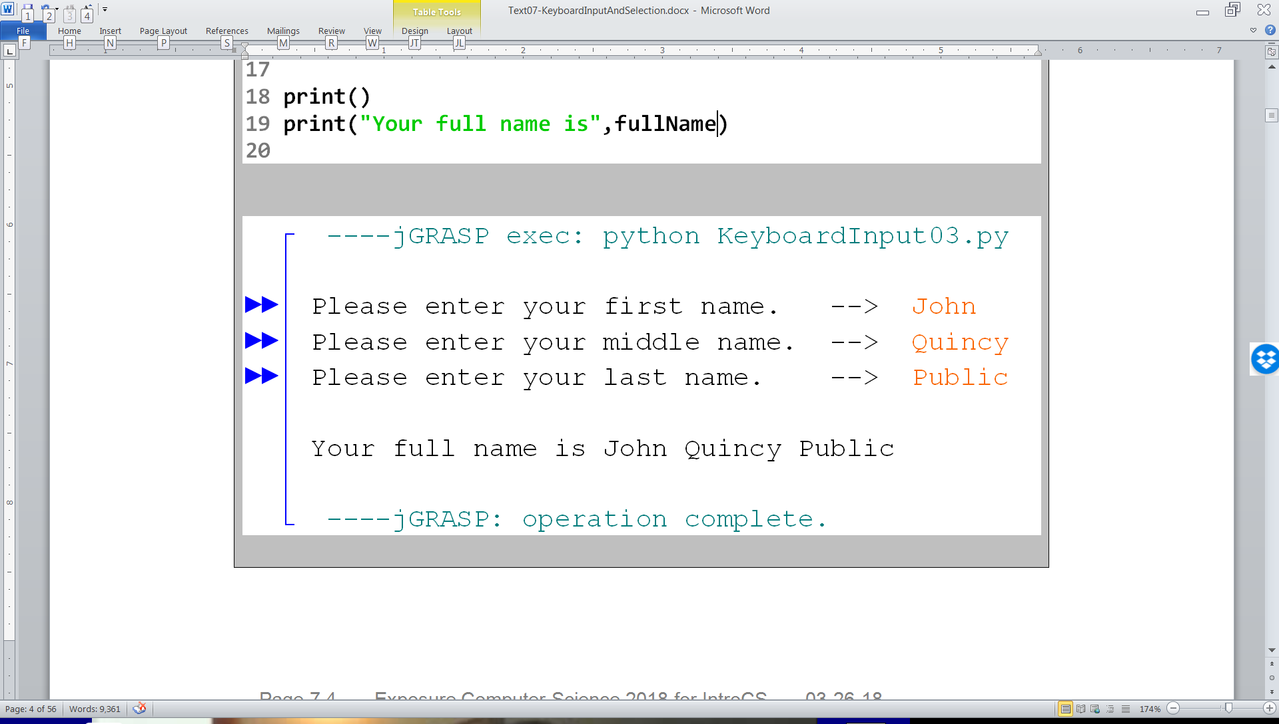

Slide 11
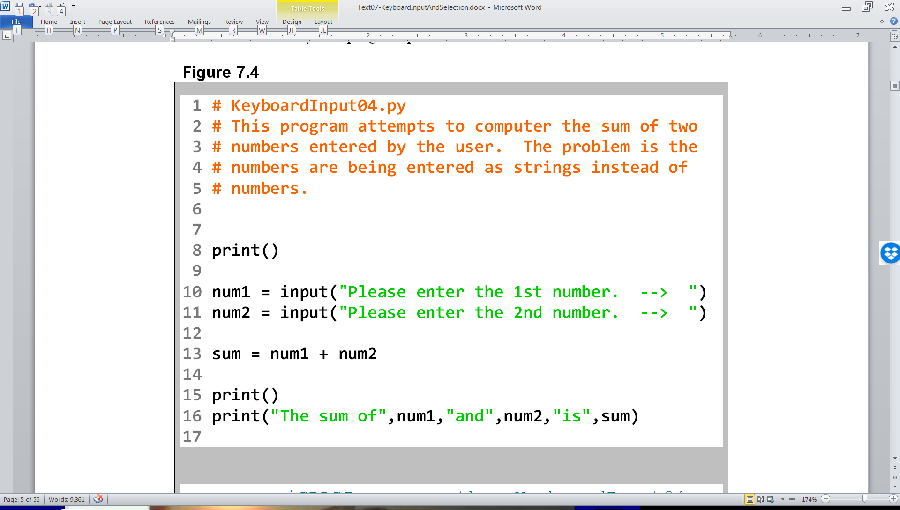

Slide 12
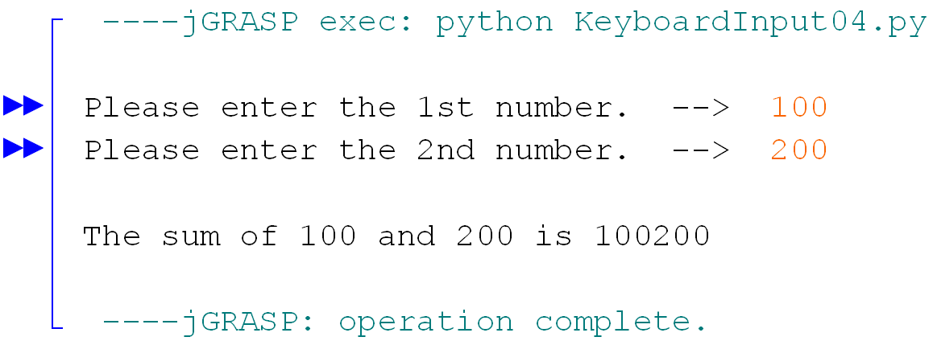

Slide 13
Addition vs. Concatenation
The problem with the previous program is that, by itself, the input command returns a string value.
When the plus sign ( + ) is used with these string values, we get String Concatenation instead of addition.
If you want keyboard input to be evaluated as a number, you need to use the eval command with input. This will give you number input.

Slide 14
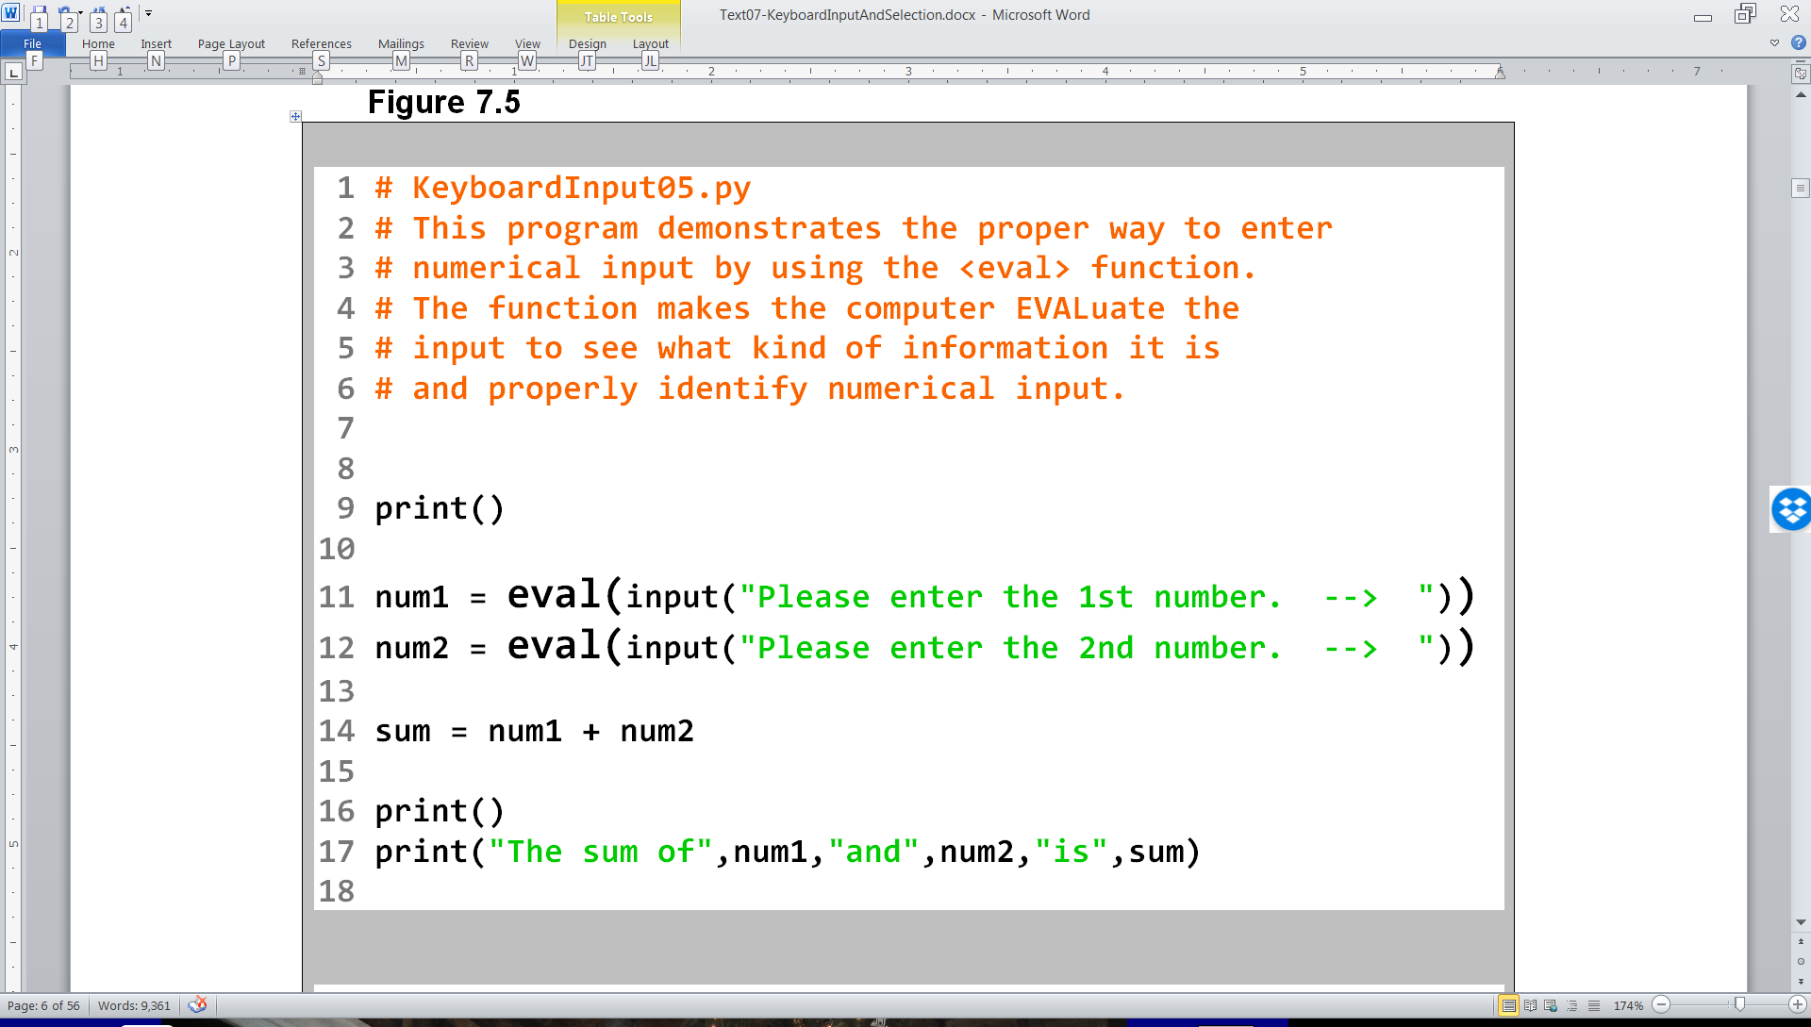

Slide 15
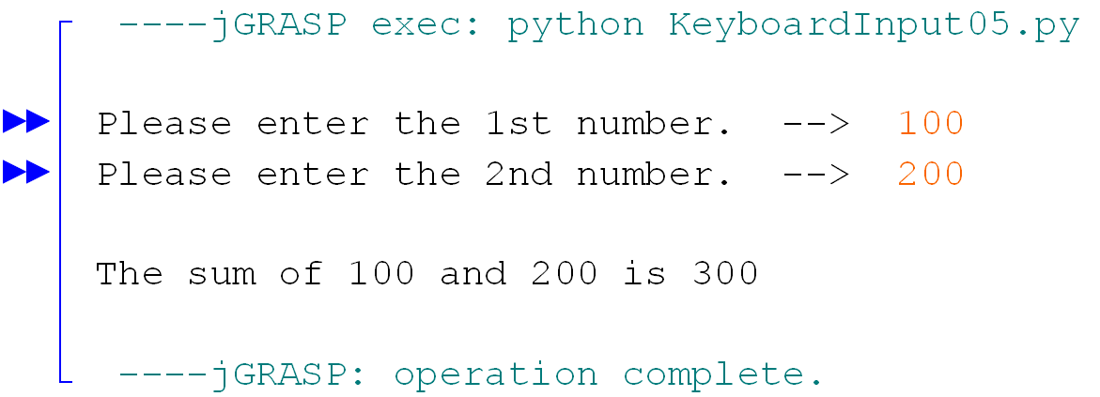

Slide 16
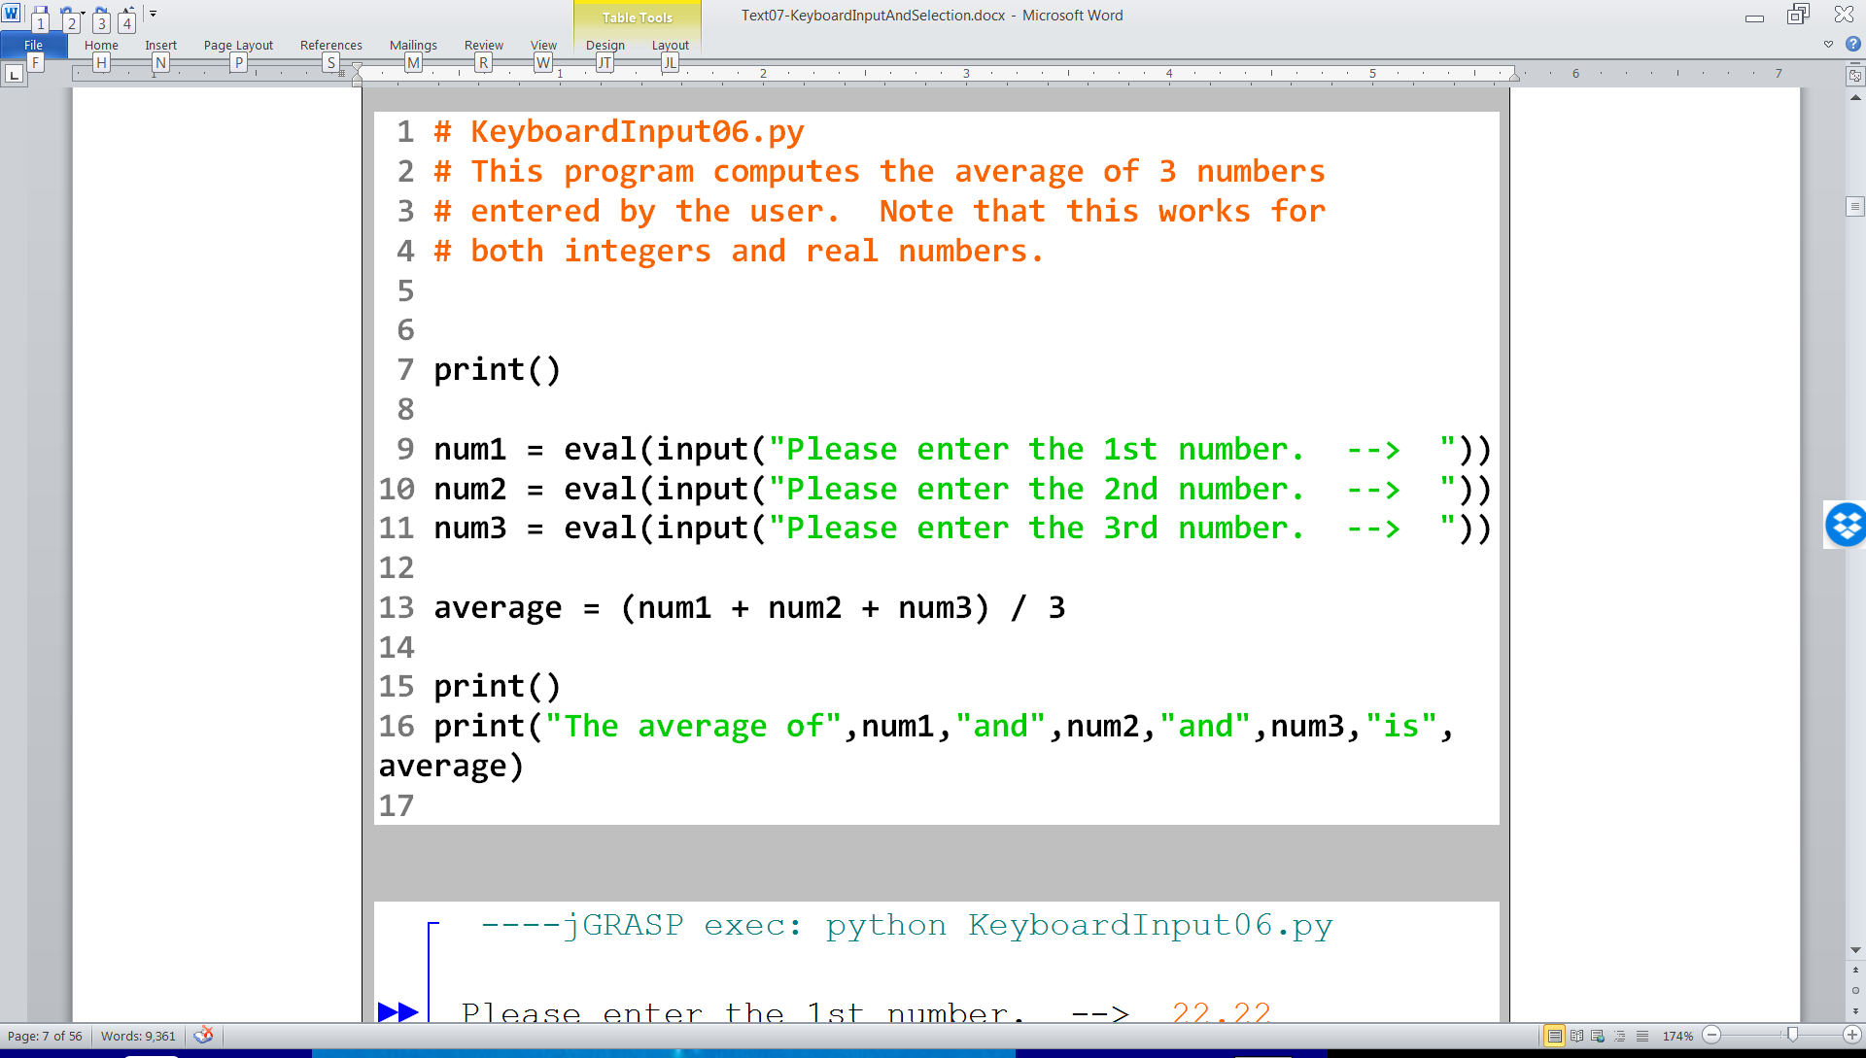

Slide 17
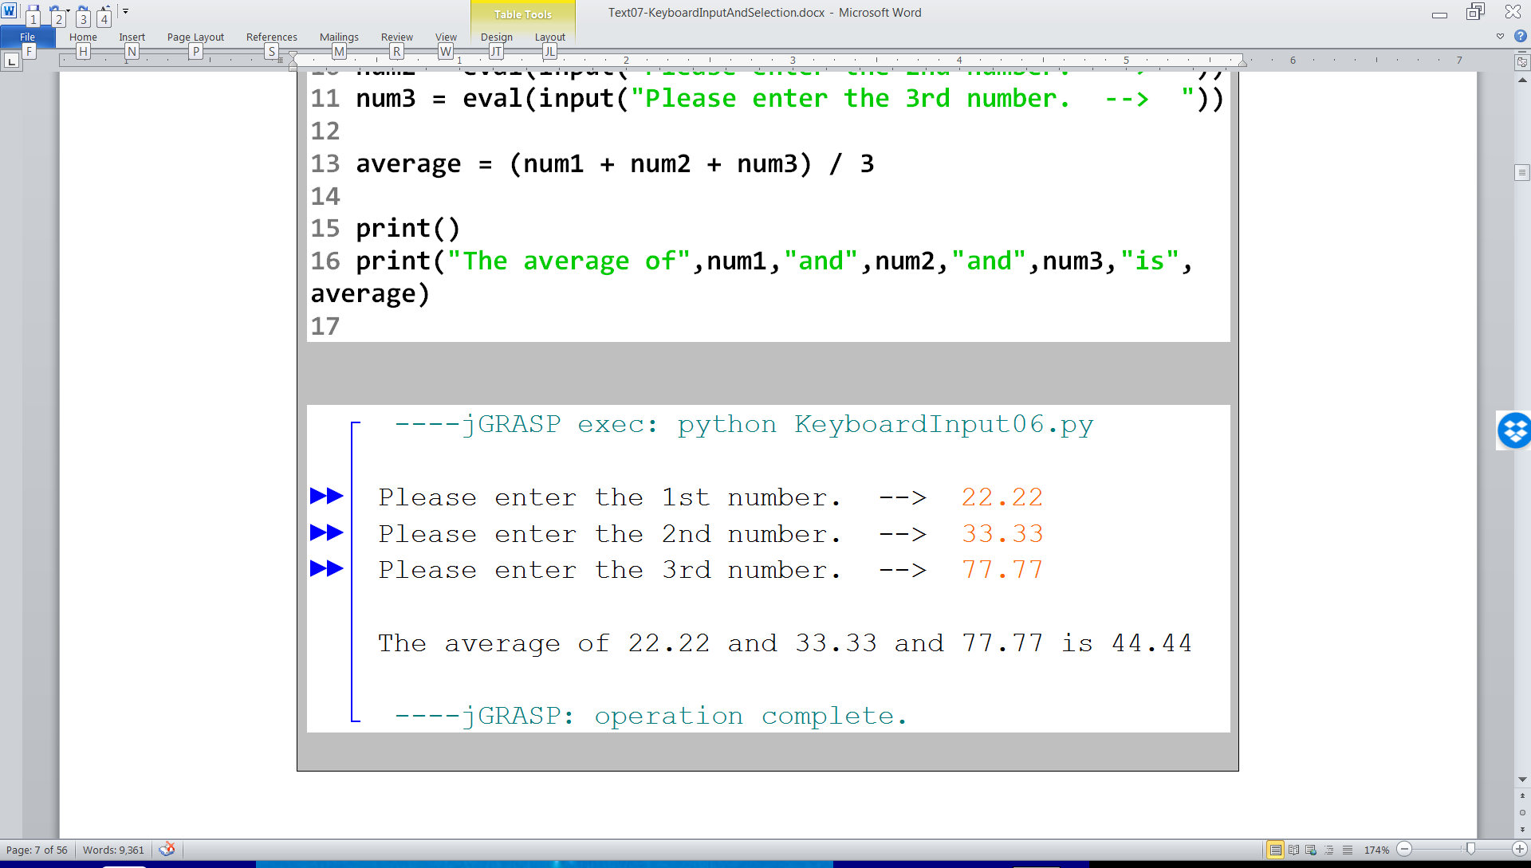

Slide 18
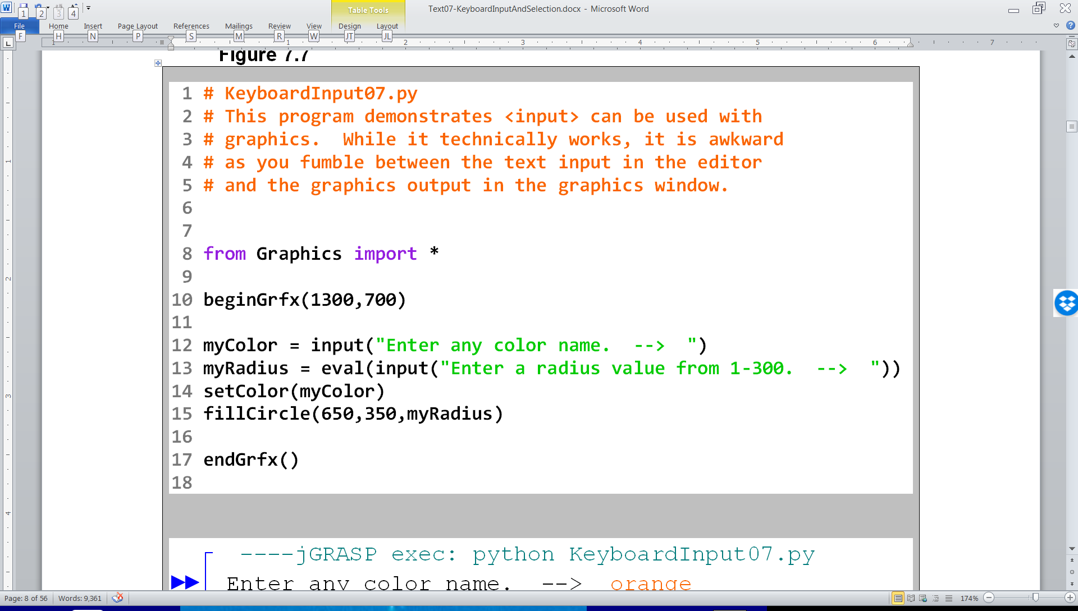

Slide 19
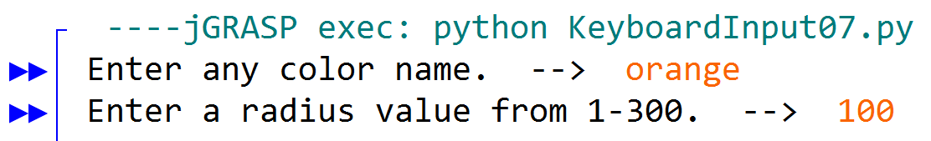
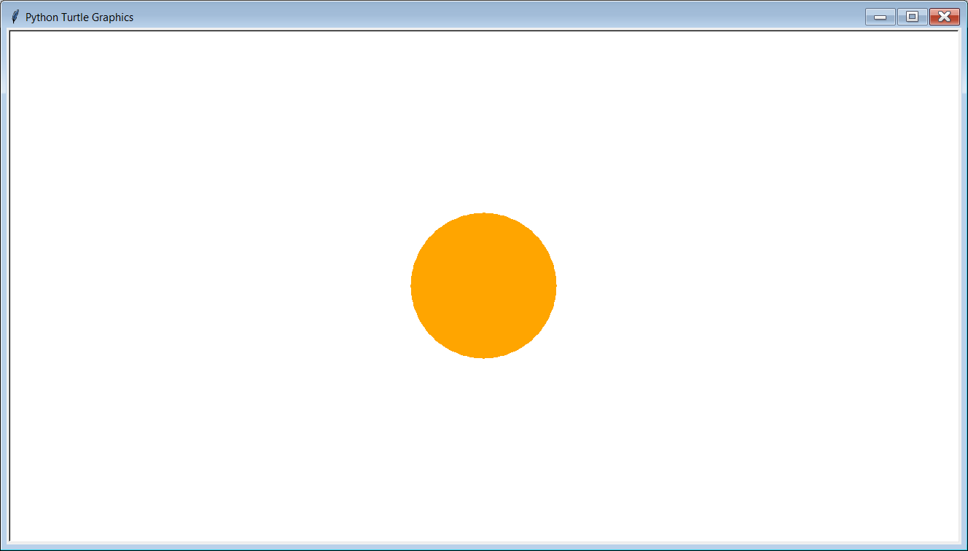

Slide 20
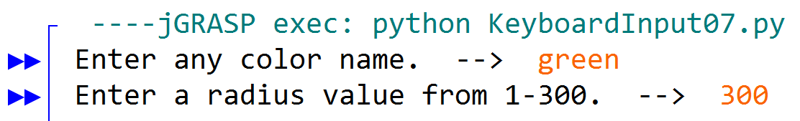
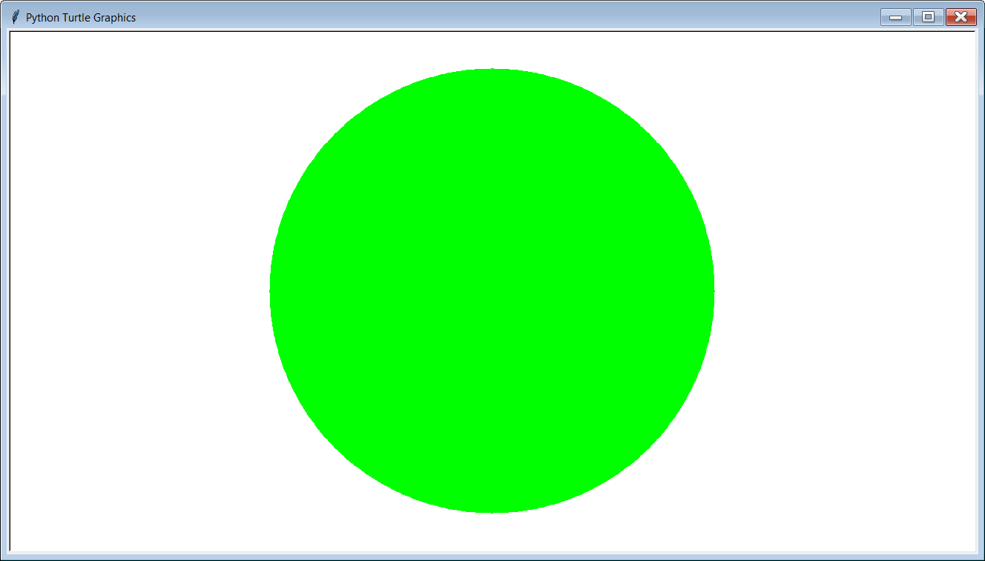

Slide 21
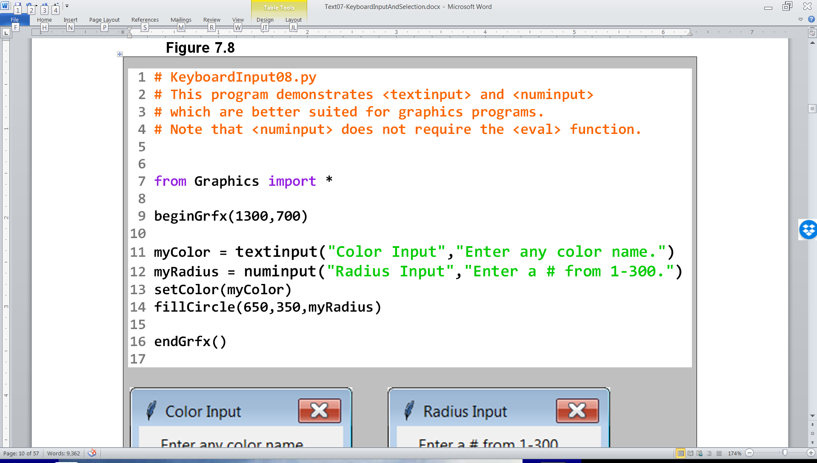

Slide 22
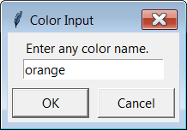
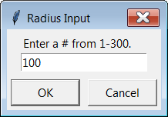

Slide 23
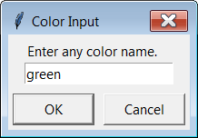


Slide 24
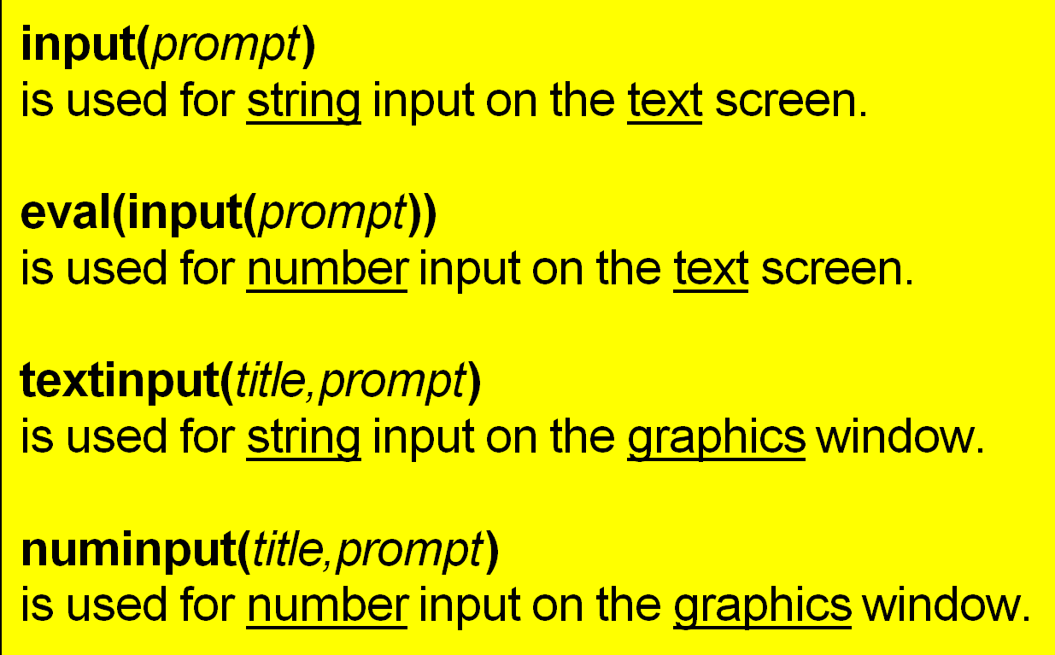
Input Functions

Slide 25
Section 7.2
Introduction to
Control Structures

Slide 26


Program Flow
Program Flow follows the exact sequence of listed program statements, unless directed otherwise by a Python control structure.

Slide 27
Section 7.3
Types of
Control Structures

Slide 28

Simple Sequence
Program Statement
Program Statement
Program Statement
Program Statement

Slide 29
One-Way Selection
Program Statement
True
Condition
Program Statement
False
Program Statement
Program Statement

Slide 30

Two-Way Selection
Program Statement
Condition
True
False
Program Statement
Program Statement
Program Statement
Program Statement

Slide 31
Multiple-Way Selection
Program Statement
True
Condition
Program Statement
False
True
Condition
Program Statement
False
True
Condition
Program Statement
False
Program Statement

Slide 32

Repetition
Program Statement
Program Statement
Program Statement
True
Condition
False
Program Statement

Slide 33
Types of Control Structures
Simple Sequence
Selection also called:
- Decision Making
- Conditional Branching
- Alternation
Repetition also called:
- Looping
- Iteration

Slide 34
Conditional Statement Definition
A conditional statement is a program expression that evaluates to True or False.
Most conditional statements require a relational operator.
All conditions end with a colon ( : ).

Slide 35
Section 7.4
Relational
Operators

Slide 36
Relational Operators
Name | Operator | Expression | Evaluates
Equals | == | 5 == 5 5 == 10 | True False
Not Equals | != | 50 != 25 100 != 100 | True False
Less than | < | 100 < 200 200 < 100 | True False
Greater than | > | 200 > 100 200 > 200 | True False
Less than or equals | <= | 100 <= 200 200 <= 200 200 <= 100 | True True False
Greater than or equals | >= | 100 >= 200 200 >= 200 200 >= 100 | False True True

Slide 37
Important Note:
The relational operators shown on the previous slide will be used in the Python example programs that demonstrate the different control structures.
Be careful not to confuse the equality operator ( = = ) with the assignment operator ( = ).
Assignment ( = ) | Equality ( == )
x = 10 Assigns a the value of 10 to x. | if x == 10: Checks if x is equal to 10.

Slide 38
Section 7.5
Selection

Slide 39
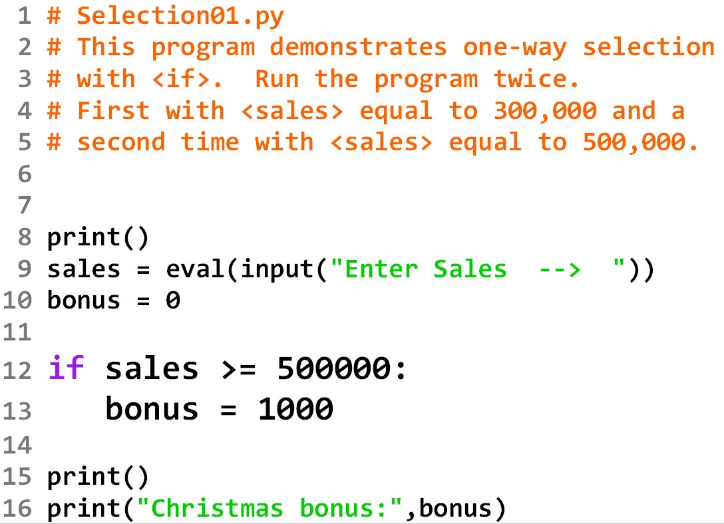

Slide 40
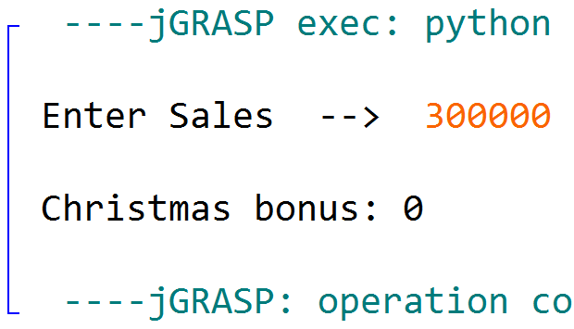

Slide 41
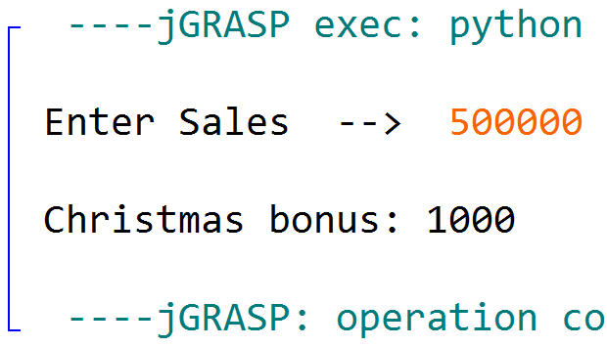

Slide 42
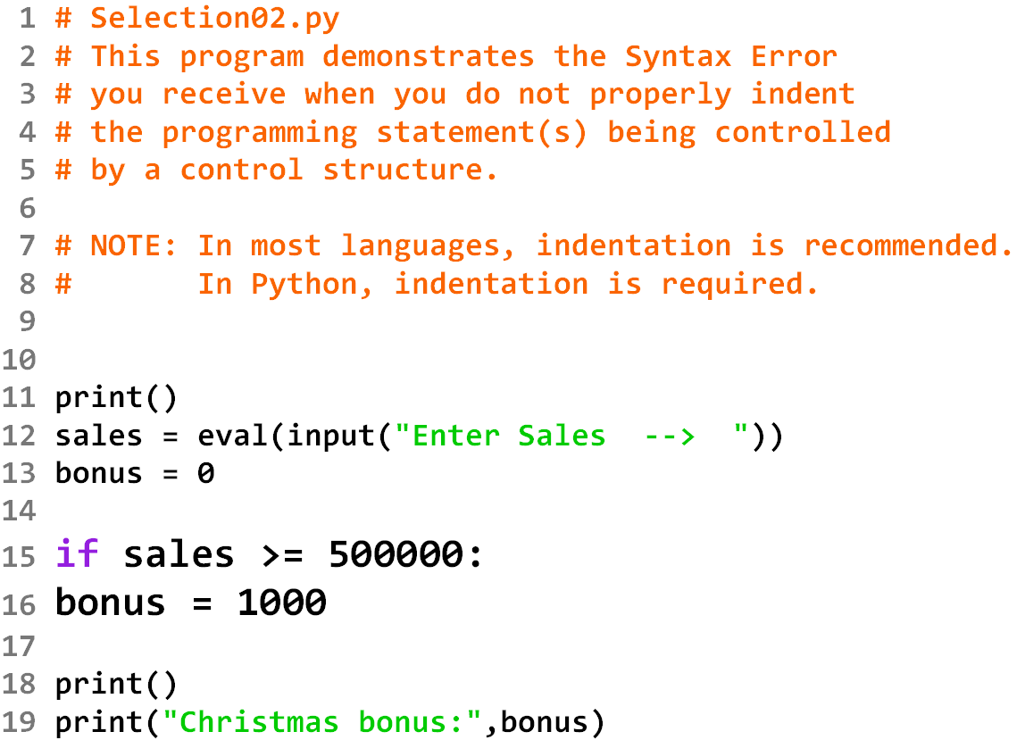

Slide 43
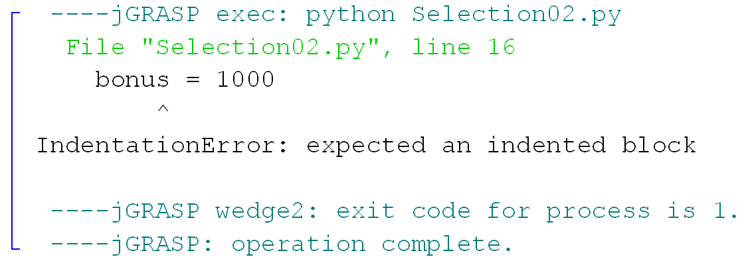

Slide 44
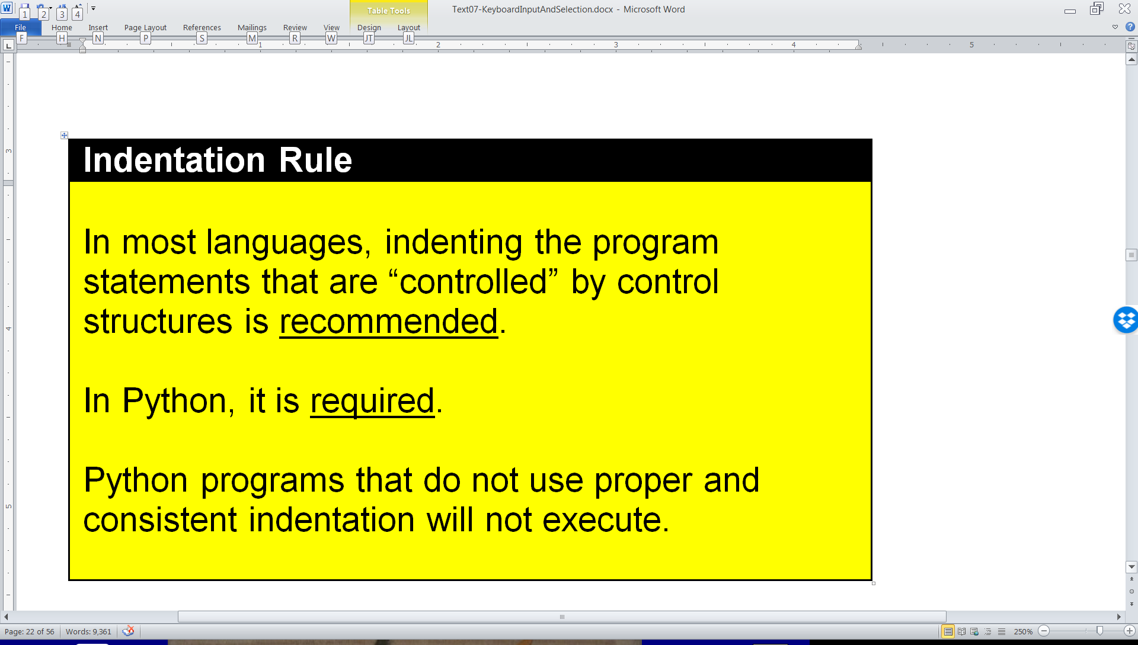

Indentation Rule:

Slide 45
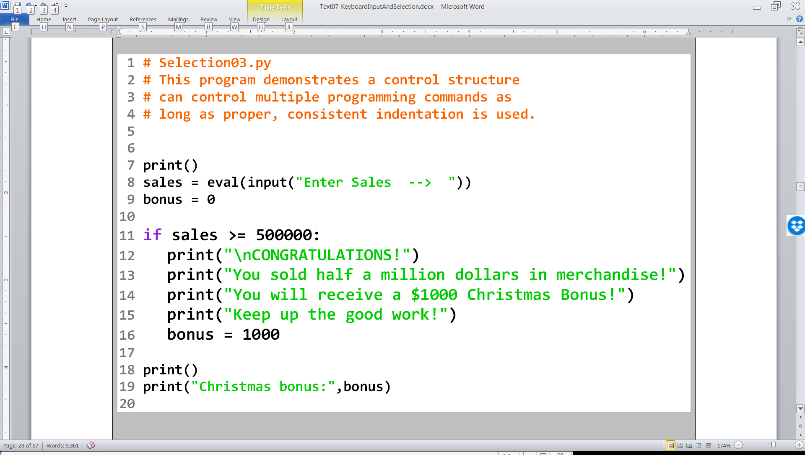

Slide 46
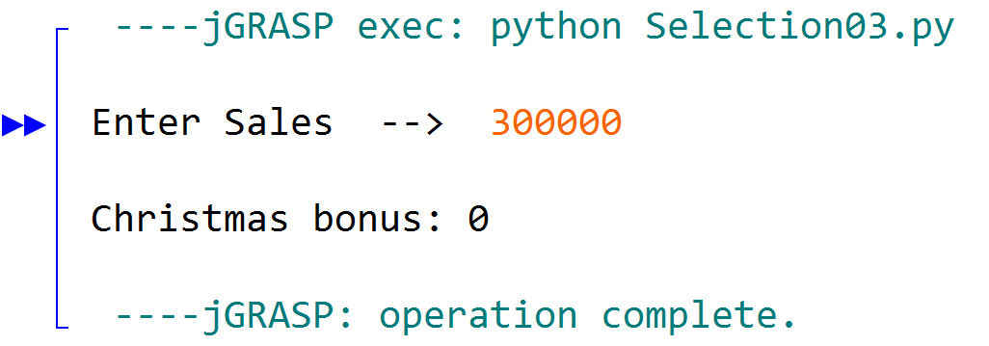

Slide 47
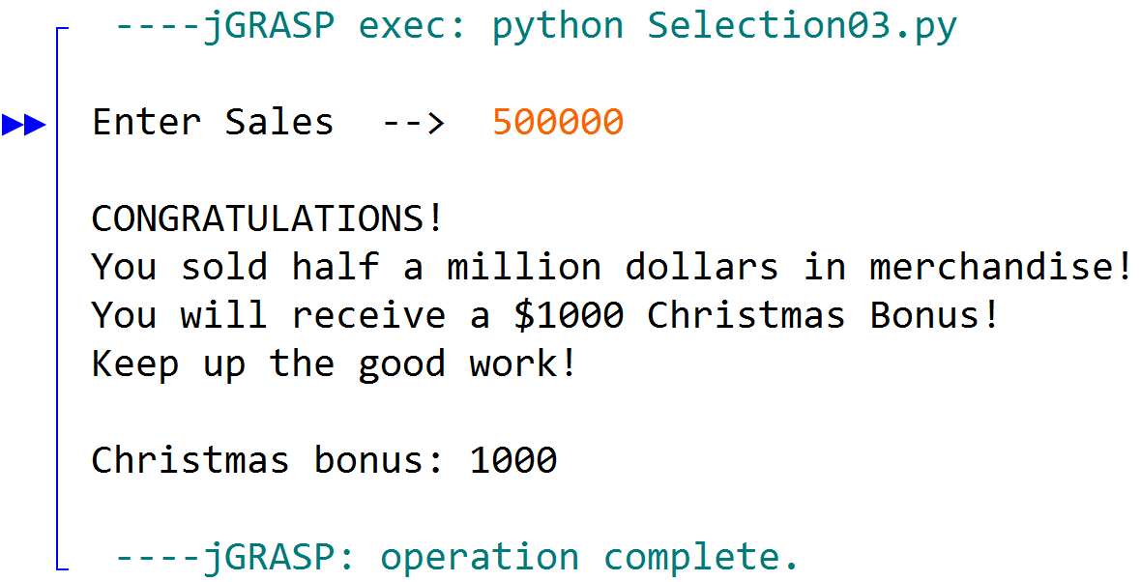

Slide 48
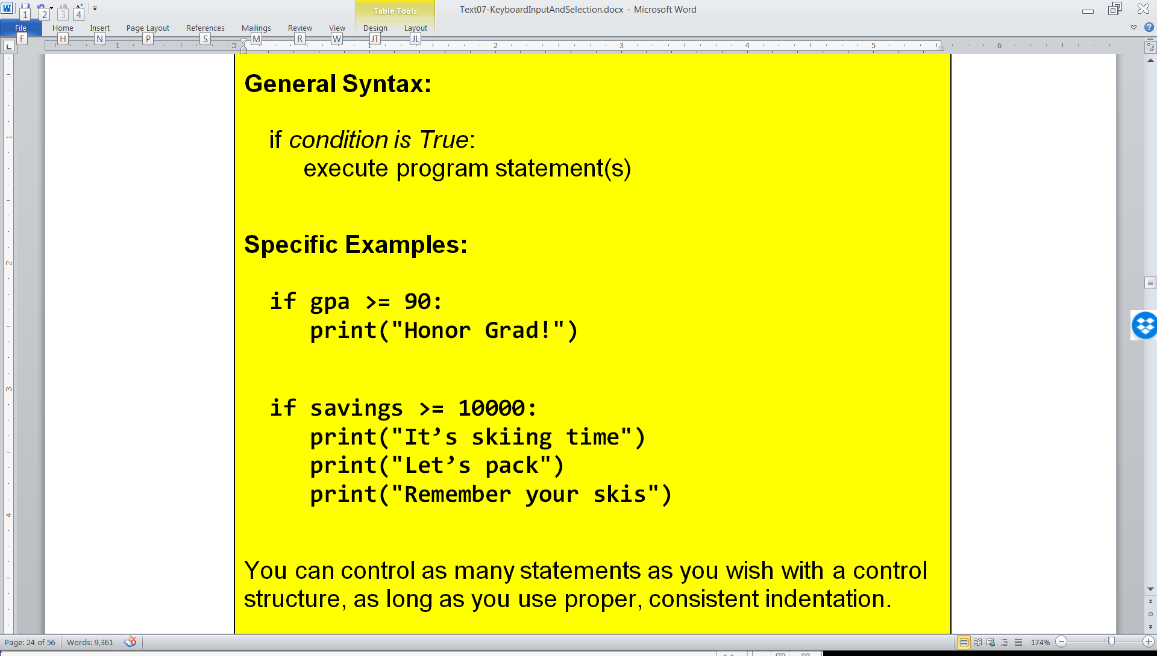

One-Way Selection

